Slide 1

The Bias Variance Tradeoff and Regularization
?
Slides by:
Joseph E. Gonzalez jegonzal@cs.berkeley.edu
Spring’18 updates:
Fernando Perez fernando.perez@berkeley.edu

Slide 2
Quick announcements
Please be respectful on Piazza
Both of your fellow students and of your teaching staff.
The teaching team monitors Piazza, but you can report any issues directly to Profs. Gonzalez and/or Perez.
Our infrastructure isn’t perfect
We’re working hard on improving it.
We’re building the plane while we fly it, full of passengers.
We have a textbook: textbook.ds100.org
It’s a work in progress!

Slide 3
Linear models for non-linear relationships
Advice for people who are dealing with non-linear relationship issues but would really prefer the simplicity of a linear relationship.

Slide 4
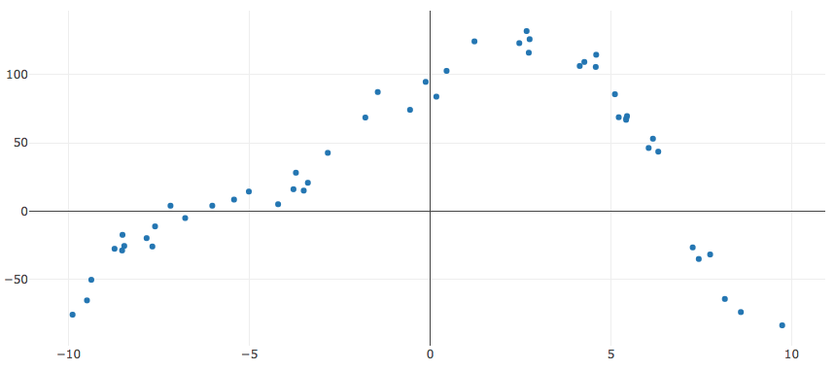
Is this data Linear?
What does it mean to be linear?

Slide 5
What does it mean to be a linear model?
In what sense is the above model linear?
Are linear models linear in the
the features?
the parameters?

Slide 6
Introducing Non-linear Feature Functions
One reasonable feature function might be:
That is:
This is still a linear model, in the parameters

Slide 7
What are the fundamental challenges in learning?

Slide 8
Fundamental Challenges in Learning?
Fit the Data
Provide an explanation for what we observe
Generalize to the World
Predict the future
Explain the unobserved
Is this cat grumpy or are we overfitting to human faces?

Slide 9
Fundamental Challenges in Learning?
Bias: the expected deviation between the predicted value and the true value
Variance: two sources
Observation Variance: the variability of the random noise in the process we are trying to model.
Estimated Model Variance: the variability in the predicted value across different training datasets.

Slide 10
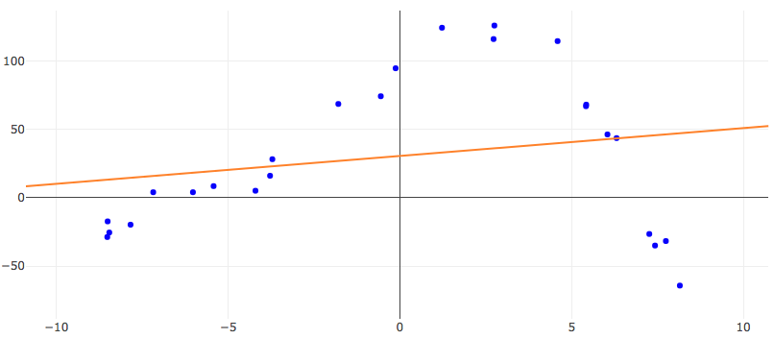
Bias
The expected deviation between the predicted value and the true value
Depends on both the:
choice of f
learning procedure
Under-fitting
All possible functions
Possible θ values
Bias
True Function

Slide 11
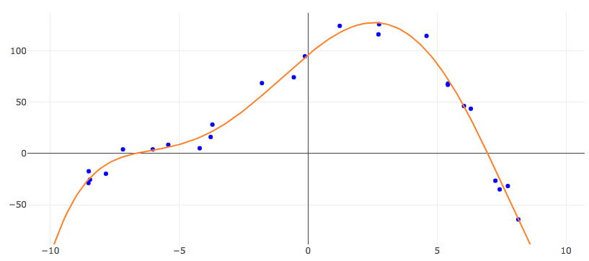
Observation Variance
the variability of the random noise in the process we are trying to model
measurement variability
stochasticity
missing information
Beyond our control (usually)

Slide 12
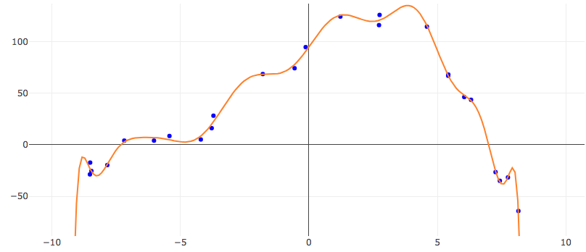
Estimated Model Variance
variability in the predicted value across different training datasets
Sensitivity to variation in the training data
Poor generalization
Overfitting

Slide 13
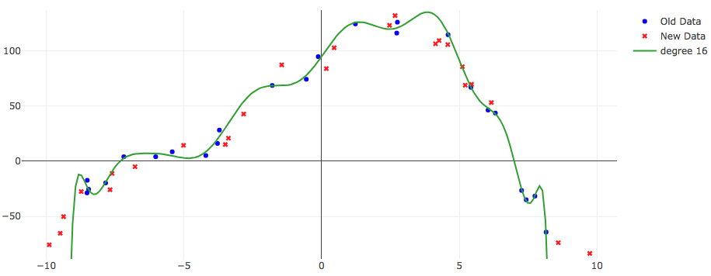
Estimated Model Variance
variability in the predicted value across different training datasets
Sensitivity to variation in the training data
Poor generalization
Overfitting

Slide 14
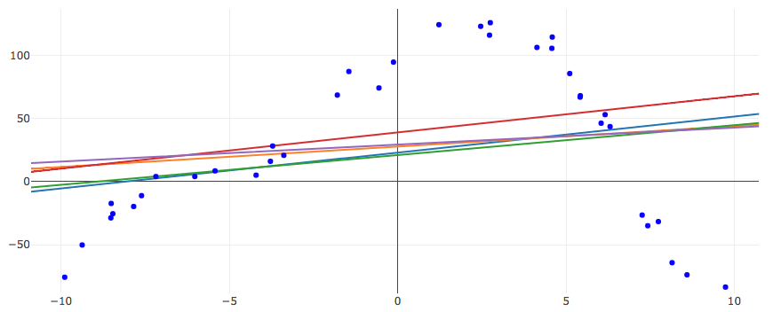
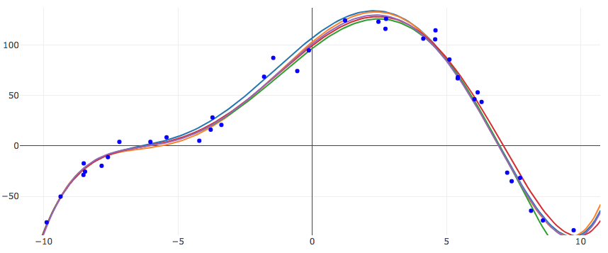
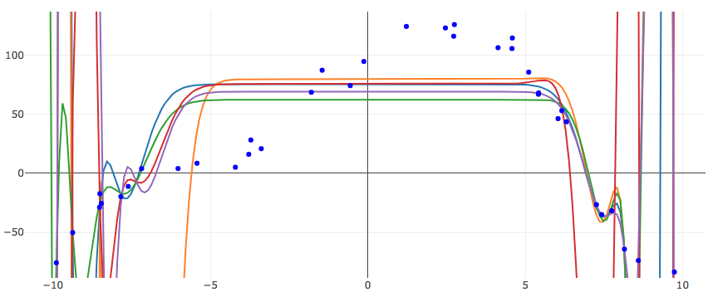
The Bias-Variance Tradeoff
Estimated Model Variance
Bias

Slide 15
Visually
The red center of the board: the true behavior of the universe.
Each dart: a specific function, that models the universe
Our parameters select these functions..
From Understanding the Bias-Variance Tradeoff, by Scott Fortmann-Roe

Slide 16
Demo

Slide 17
Analysis of the Bias-Variance Trade-off

Slide 18
Analysis of Squared Error
Noise term:
For the test point x the expected error:
Random variables are red
True Function
Assume noisy observations → y is a random variable
Assume training data is random → θ is a random variable

Slide 19
Analysis of Squared Error
Goal:
=
Obs. Var. +
(Bias)² +
Mod. Var.
Other terminology:
“Noise” +
(Bias)² +
Variance

Slide 20
=
Subtracting and adding h(x)
Useful Eqns:

Slide 21
=
Expanding in terms of a and b:
=
Useful Eqns:

Slide 22
=
Expanding in terms of a and b:
=
Independence of ϵ and θ
Useful Eqns:
0

Slide 23
=
=
Obs. Variance
“Noise” Term
Obs. Value
True Value
Model Estimation
Error
Useful Eqns:
True Value
Pred. Value

Slide 24
Next we will show….
(Bias)²
Model Variance
How?
Adding and Subtracting what?

Slide 25
Expanding in terms of a and b:

Slide 26
Constant

Slide 27
Constant
0

Slide 28
Constant

Slide 29
Model Variance
(Bias)²

Slide 30
=
Obs. Variance
“Noise”
(Bias)²
Model Variance

Slide 31
Bias Variance Plot
Test Error
Optimal Value
Test Error
Optimal Value
Variance
Variance
(Bias)²
Increasing Model Complexity
Notes:
Image

Slide 32
Bias Variance Increasing Data
Optimal Value
Test Error
Optimal Value
Test Error
Variance
Variance
(Bias)²
Increasing Model Complexity
Notes:
Image

Slide 33
How do we control model complexity?
So far:
Number of features
Choices of features
Next: Regularization
Test Error
Optimal Value
Test Error
Optimal Value
Variance
Variance
(Bias)²
Increasing Model Complexity

Slide 34
Bias Variance Derivation Quiz
http://bit.ly/ds100-sp18-bvt
Match each of the following:
0
Bias²
Model Variance
Obs. Variance
h(x)
h(x) + ϵ
(1)
(2)
(3)
(4)

Slide 35
Bias Variance Derivation Quiz
http://bit.ly/ds100-sp18-bvt
Match each of the following:
0
Bias²
Model Variance
Obs. Variance
h(x)
h(x) + ϵ
(1)
(2)
(3)
(4)

Slide 36
Regularization Parametrically Controlling the Model Complexity
𝜆
Tradeoff:
Increase bias
Decrease variance

Slide 37
Basic Idea of Regularization
Penalize
Complex Models
Fit the Data
Regularization Parameter
How should we define R(θ)?
How do we determine 𝜆?

Slide 38
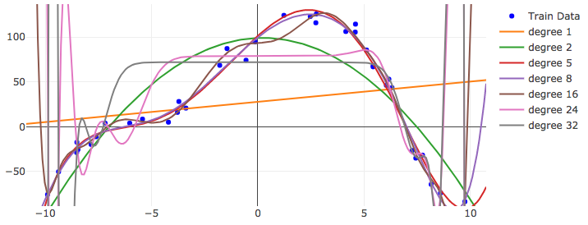
The Regularization Function R(θ)
Goal: Penalize model complexity
Recall earlier:
More features → overfitting …
How can we control overfitting through θ
Proposal: set weights = 0 to remove features
Notes:
Notes:
- Any regularization is a type of bias: It tells us how to select a model among others, absent additional evidence from the data.
- Regularization terms are independent of the data. Therefore it reduces the variance of the model.

Slide 39
Common Regularization Functions
Ridge Regression (L2-Reg)
LASSO
(L1-Reg)
Distributes weight across related features (robust)
Analytic solution (easy to compute)
Does not encourage sparsity → small but non-zero weights.
Encourages sparsity by setting weights = 0
Used to select informative features
Does not have an analytic solution → numerical methods
Notes:
Least Absolute Shrinkage and Selection Operator

Slide 40
Regularization and Norm Balls
Loss
𝜃₂
𝜃_{opt}
𝜃₁

Slide 41
Regularization and Norm Balls
Loss
Loss
Loss
𝜃₂
𝜃₂
𝜃_{opt}
𝜃₂
𝜃_{opt}
𝜃_{opt}
Snaps to
corners
Snaps to
corners
𝜃₁
𝜃₁
𝜃₁
Weight sharing
Sparsity
inducing
Compromise…
Two parameters …
L2 Norm (Ridge)
L1 Norm (LASSO)
L1 + L2 Norm
(Elastic Net)
Notes:
- Note the isosurfaces for the various Lp norms - the L1 isosurface shows why any increase in value of any parameter has to be offset by an equal decrease in the value of another.

Slide 42
Python Demo!
The shapes of the norm balls.
Maybe show reg. effects on actual models.

Slide 43
Determining the Optimal 𝜆
Value of 𝜆 determines bias-variance tradeoff
Larger values → more regularization → more bias → less variance

Slide 44
Summary
Regularization

